Slide 1
MusicNet Progress
Leonardo Caputo
Matthias Maes
Matthias Cami
Bhawna Dixit

Slide 2
Descriptors
•High Level: Instrument, key, chords, tempo, rhythm
•Mid-Level: Pitch and beat related descriptors, onset of note
•Low-Level: Amplitude, energy, spectral features

Slide 3
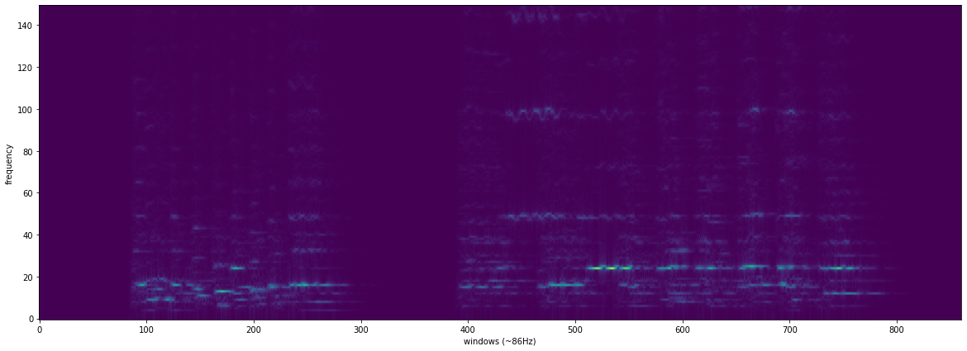
The vertical axis represents the frequency (Hz), which is related to the pitches of the notes. The lower frequencies are at the bottom and the higher at the top. It is possible to distinguish different colours that represent the magnitudes, also called as levels of energy. In Figure, blue means that there is no energy (low magnitudes) and green represents the high magnitudes. The main reason to use a frequency representation instead of the original audio signal is because it is easier to distinguish the musical notes using spectrograms, so the neural network can faster process and learn from this data.
Regarding to the windows applied in the transformations, there are different shapes and sizes to take into account while calculating an FFT. Depending on the size of the Fourier analysis window, different levels of frequency/time resolution are achieved.
The size also affects to the resolution of the spectrogram, the bigger the window is, the better frequency resolution is possible to obtain, although lowering the temporal resolution.

Slide 4
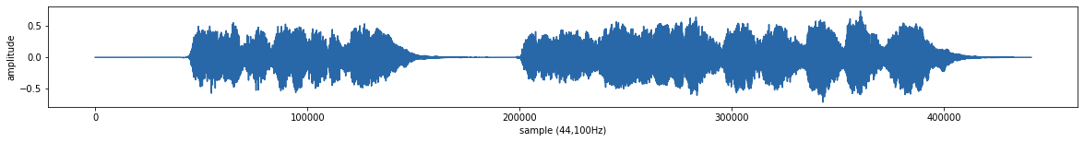
Sample audio 2494
The figure shows evolution in time of the song recording ID 2494 as the oscillation of the signal. The Y axis represents the amplitude while the X is the time. In this kind of function it is not possible to distinguish the music that is actually playing, what music notes are present or other relevant information. Therefore, the signal is decomposed by FFT.

Slide 5
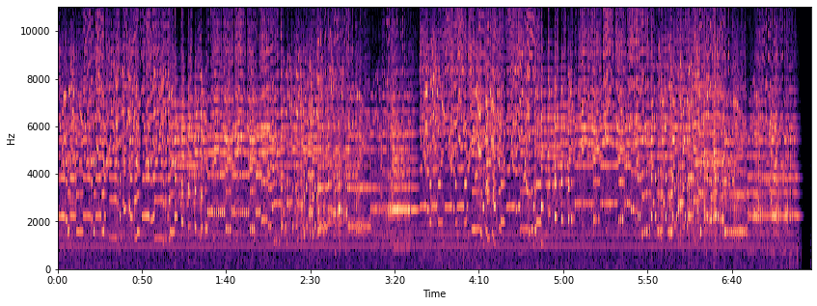
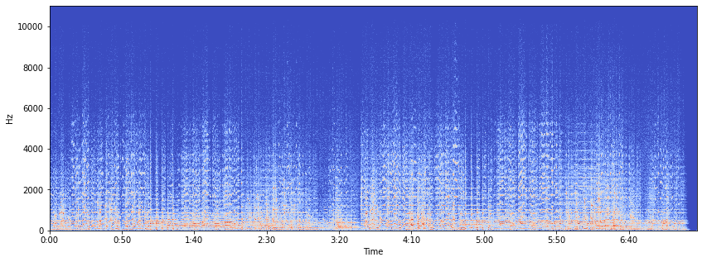
Try different transformations
Constant Q-transform
Short-Time Fourier Transform

Slide 6
Models
ResNet50
CNN

Slide 7
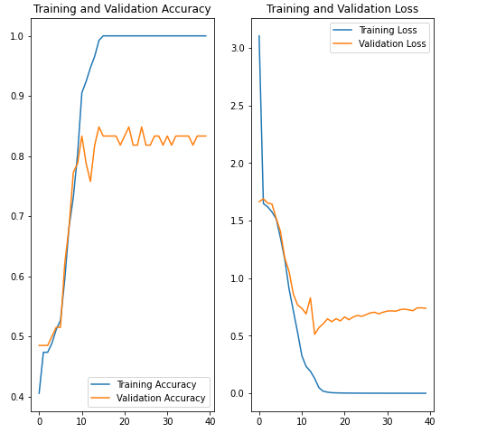
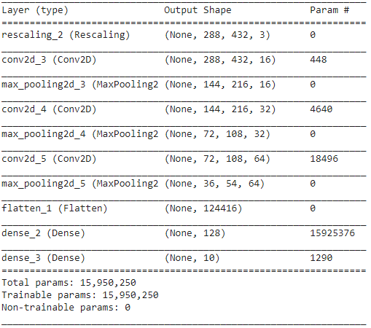
CNN

Slide 8
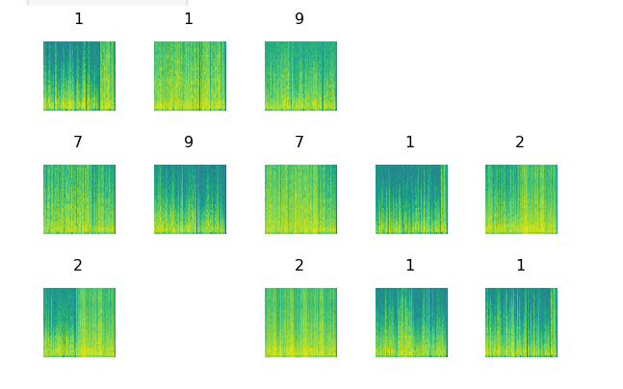
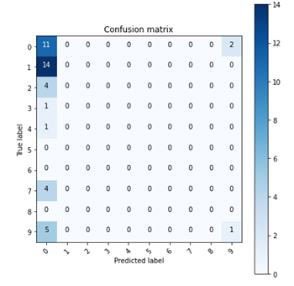
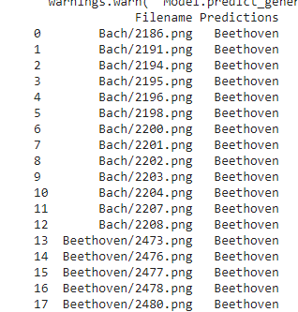
ResNet50 + Analysis

Slide 9
Tasks
Try spectrograms with different window
Try different transforms
Models

